Slide 1
FENOTIPIZZAZIONE COME GUIDA ALLA SCELTA DELLA TECNICA
LUCA BUSETT0
UNIVERSITA’ DI PADOVA

Slide 2





Luca Busetto
Full Professor of Nutrition, Department of Medicine
University of Padova
Director of the Cinical Nutrition Unit
Padova University Hospital
Centre for the Study and the Integrated management of Obesity
Padova University Hospital
Vice President of European Association for the Study of Obesity
Past President of the Italian Obesity Society (SIO)

Slide 3
Luca Busetto - Disclosures
ADVISORY BOARD MEMBER: - AMGEN
- BOEHRINGER INGELHEIM
- BRUNO FARMACEUTICI
- ELI LILLY
- NOVONORDISK - PFIZER
                - RECORDATI
                - REGENERON
                - ROCHE
SPEAKER FEES - PRONOKAL
- RYTHM PHARMACEUTICALS

Slide 4

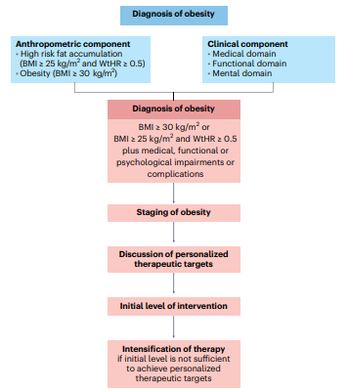

Busetto L et al. Nat Med 2024;30:2395

Slide 5
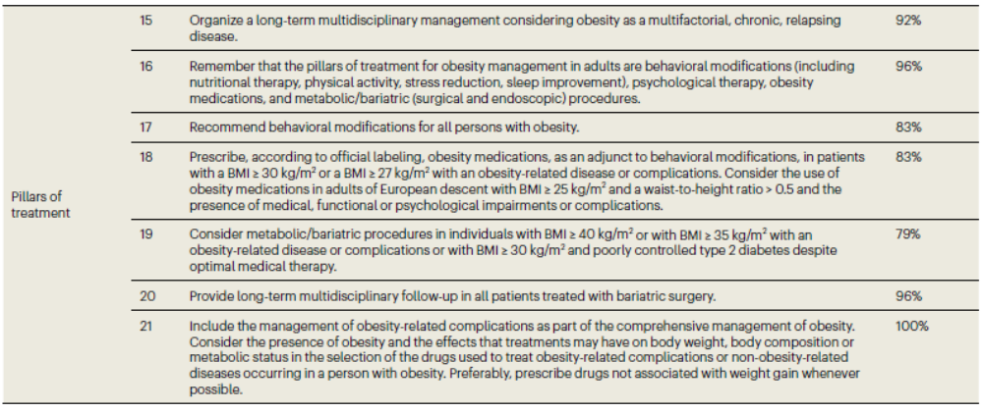
Busetto L et al. Nat Med 2024;30:2395

Slide 6
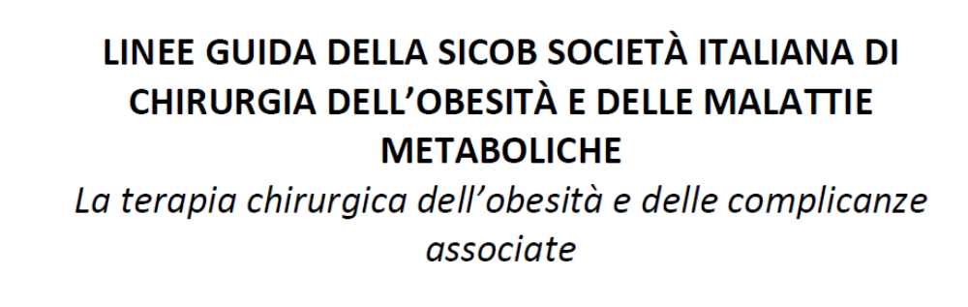

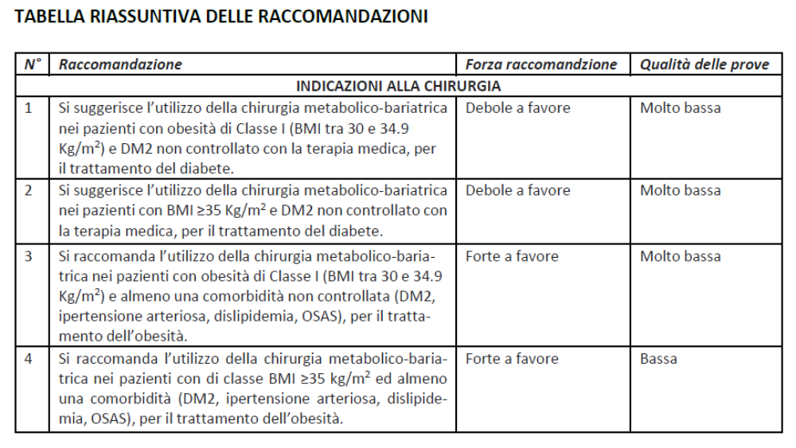

Slide 7
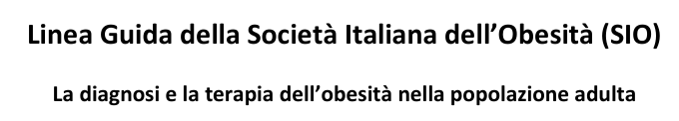

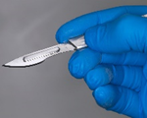
INTERVENTO EDUCATIVO STRUTTURATO
Intervento educativo ad impronta cognitivo comportamentale
BMI 25-30 kg/m² con ORC
BMI 30-35 kg/m²
BMI 35-40 kg/m²
BMI ≥ 40 kg/m²

Slide 8
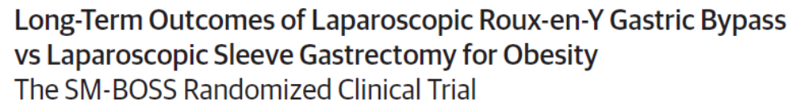
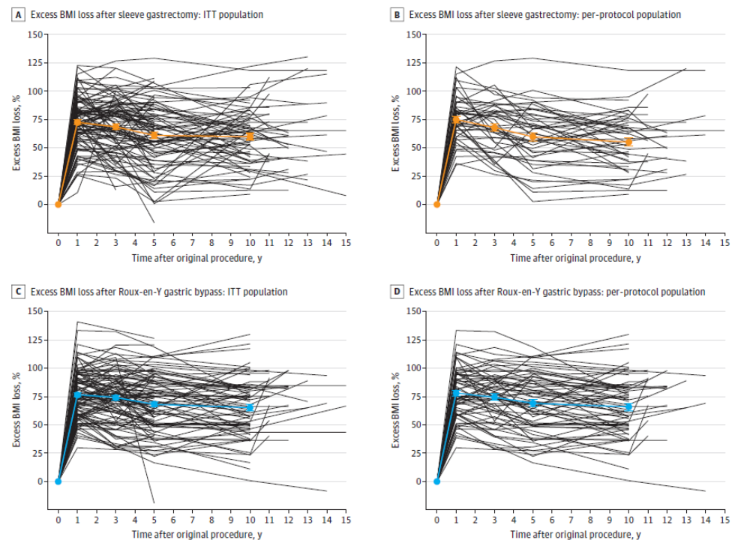
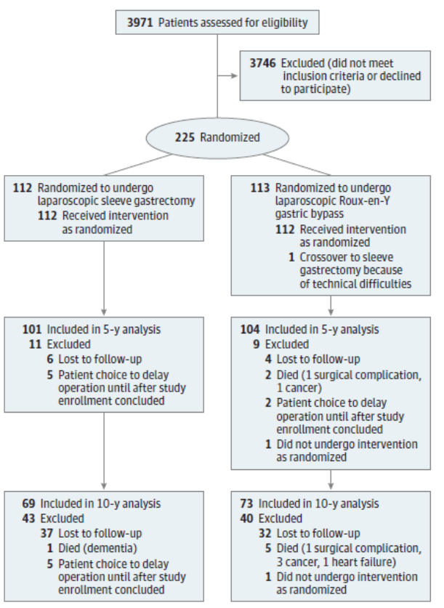
Kraljevic M et al. JAMA Surg 2025;160:369.

Slide 9
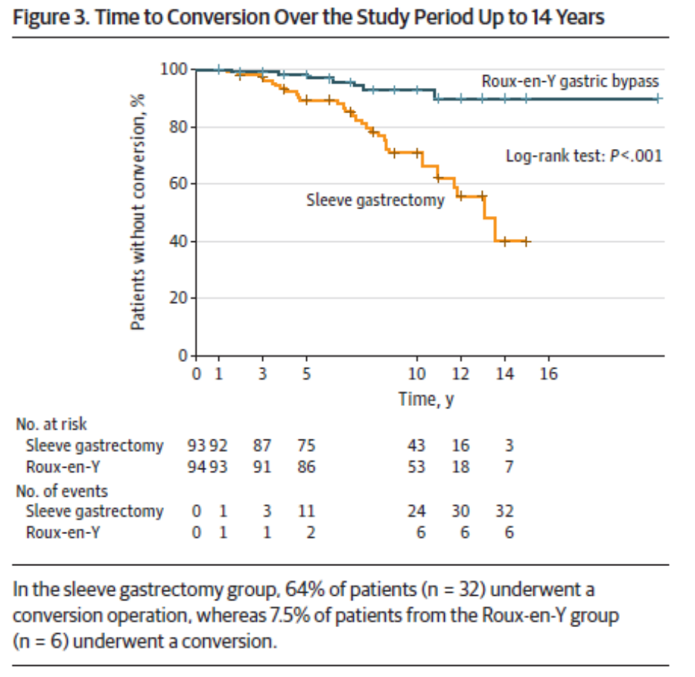
Kraljevic M et al. JAMA Surg 2025;160:369.

Slide 10
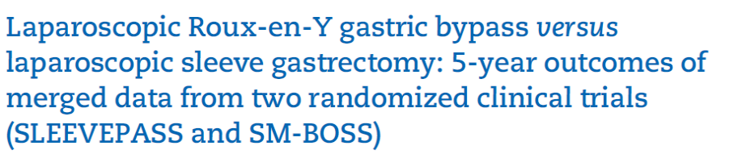
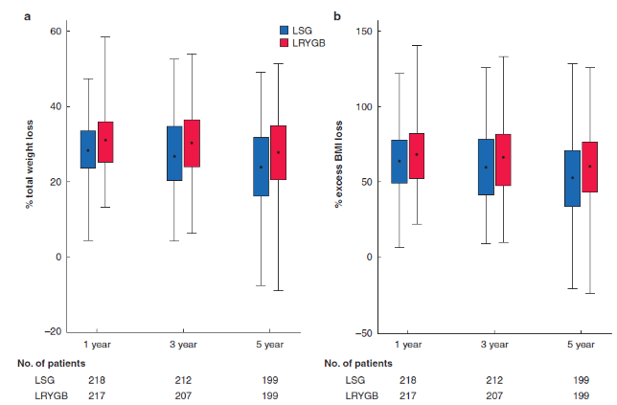
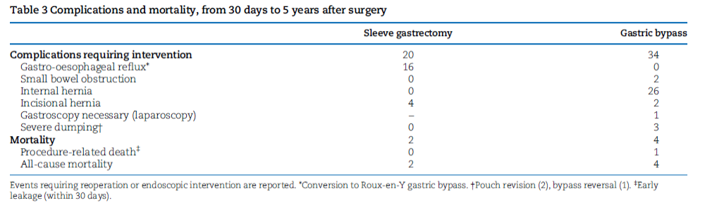
Kraljevic M et al. JAMA Surg 2025;160:369.
Wolnerhanssen BK et al. Br J Surg 2021;108:49.

Slide 11
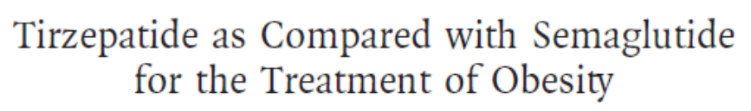
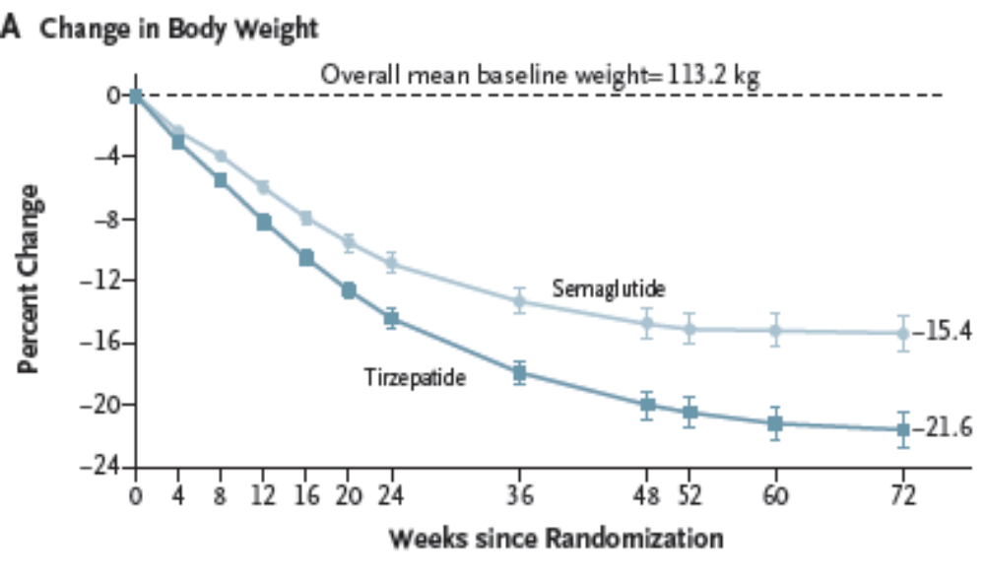
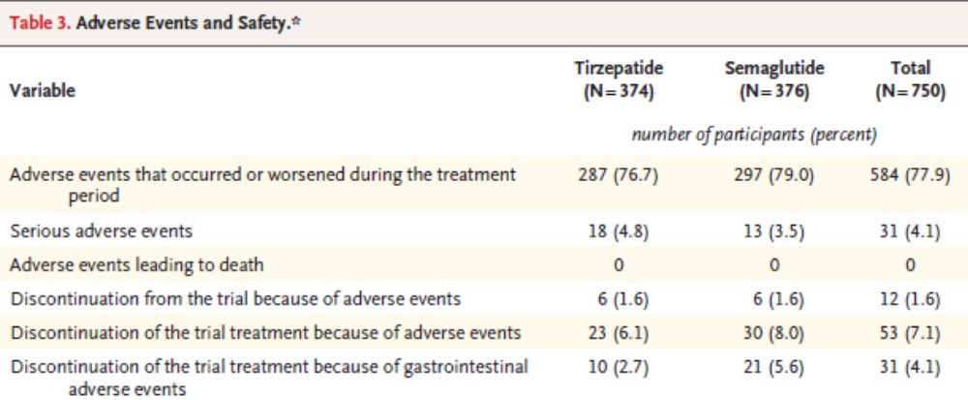
Aronne LJ et al. NEJM 2025;393:26.

Slide 12
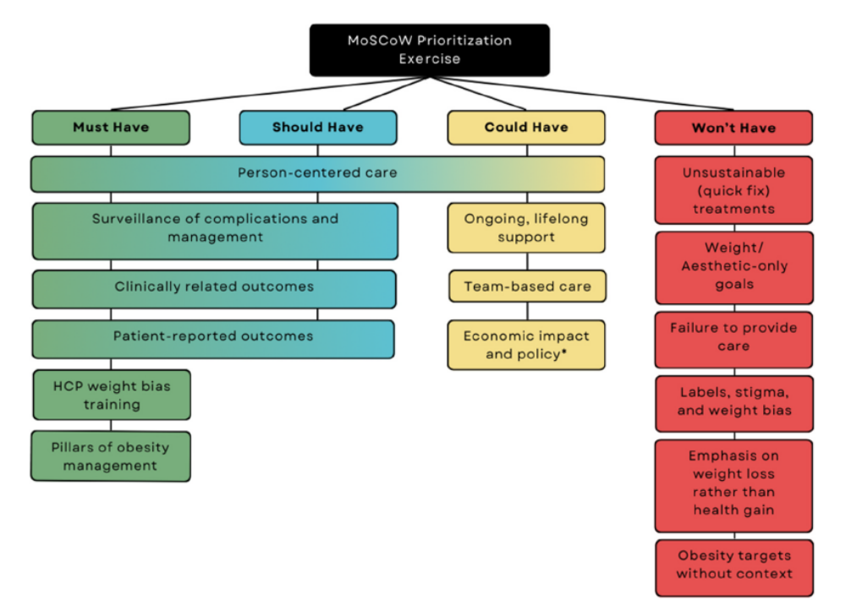
Sockalingam S et al. Obes Pillars 2026; July 30.

Slide 13
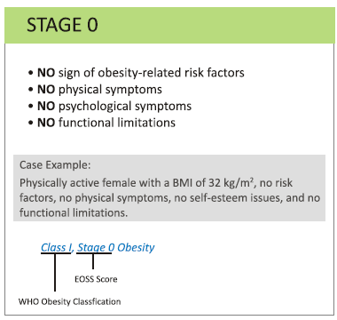
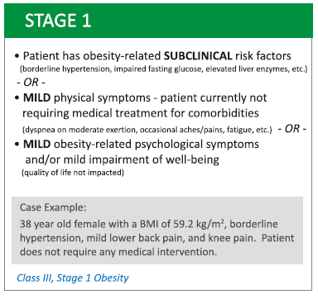
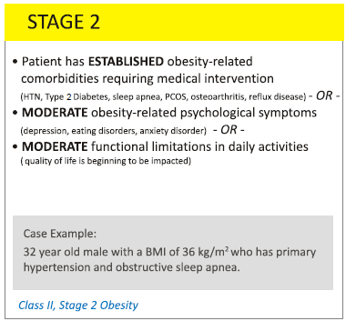
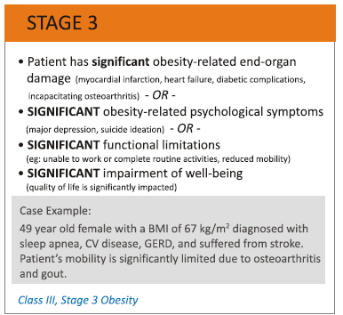
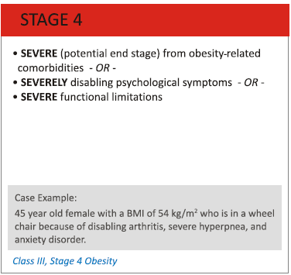
Targets in Obesity Management
EOSS
Years

Slide 14
Targets in Obesity Management

Slide 15
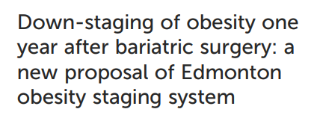
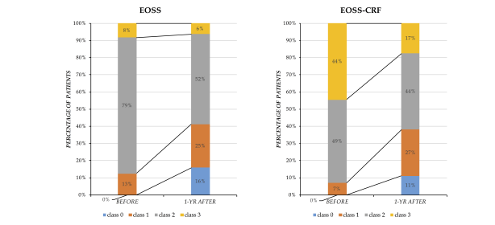
Quinto GN, Bettini S et al. Front Endocrinol 2023;14:1147171

Slide 16
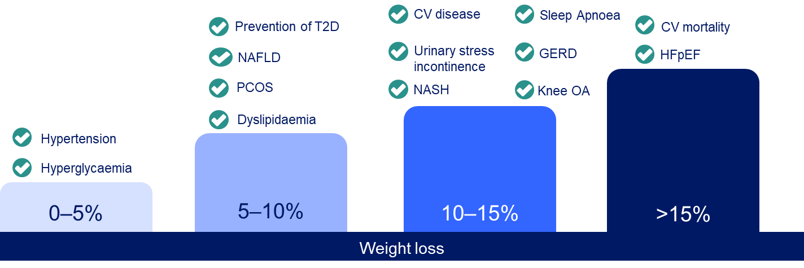
Targets in Obesity Management
Garvey WT et al. Endocr Pract, 2016;22(Suppl. 3):1
Look AHEAD Research Group. Lancet Diabetes Endocrinol, 2016;4:913
Lean ME et al. Lancet, 2018;391:541
Benraoune F and Litwin SE. Curr Opin Cardiol, 2011;26:555
Sundström J et al. Circulation, 2017;135:1577

Slide 17
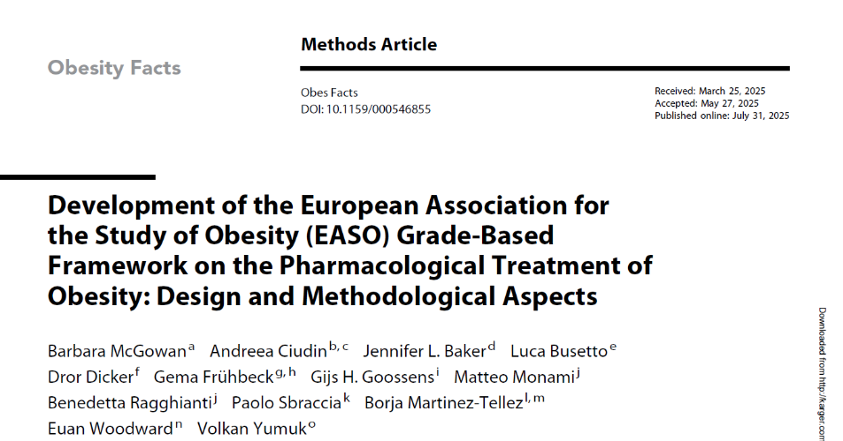
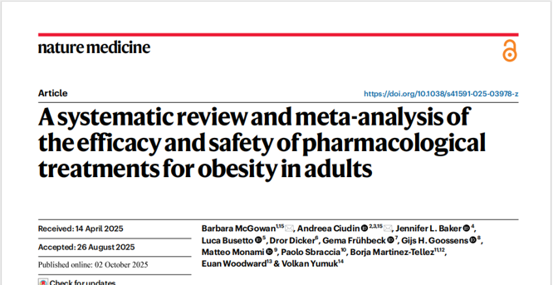
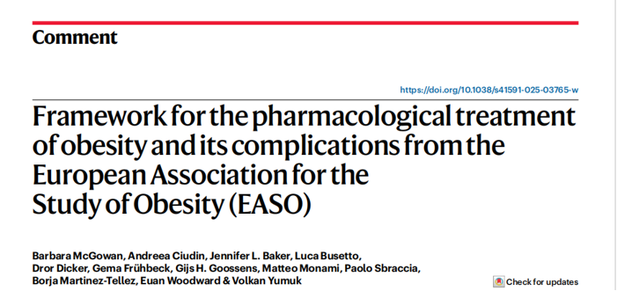

Slide 18
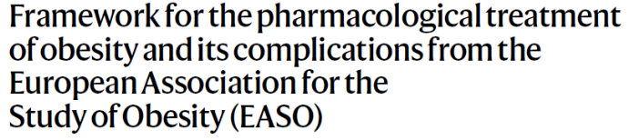
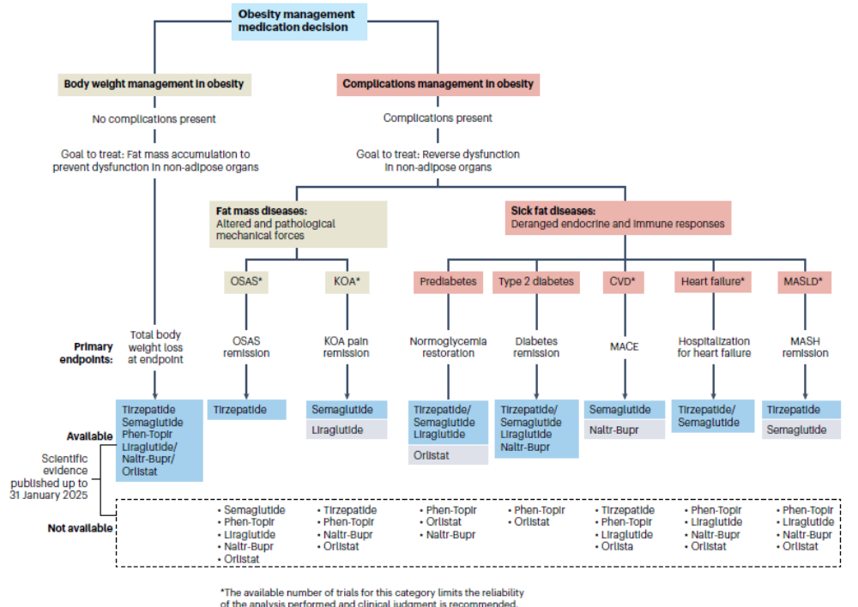
McGowan B et al. Nat Med 2025;31:3229

Slide 19
2025 EASO Framework
New RCT Evidence
Living Evidence Map
The 2025 EASO OMM algorithm (v1) was designed as a pragmatic, time-stamped framework to align treatment goals with comparative RCT evidence.
Since V1, additional RCTs have emerged - especially for body weight outcomes and histological liver outcomes in MASH/MASLD.
The update (v2) preserves the original methodology and modifies the algorithm only where new evidence meaningfully supports greater precision and guidance.
Updated framework aligns latest comparative RCT evidence to personalised treatment goals across key obesity-related outcomes and complications.

Slide 20
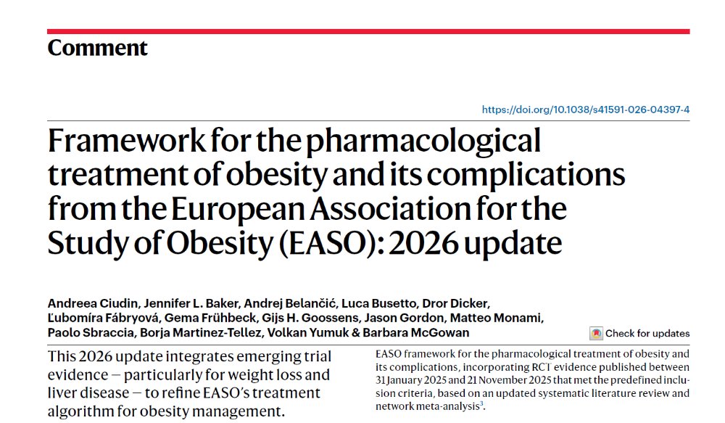

Slide 21
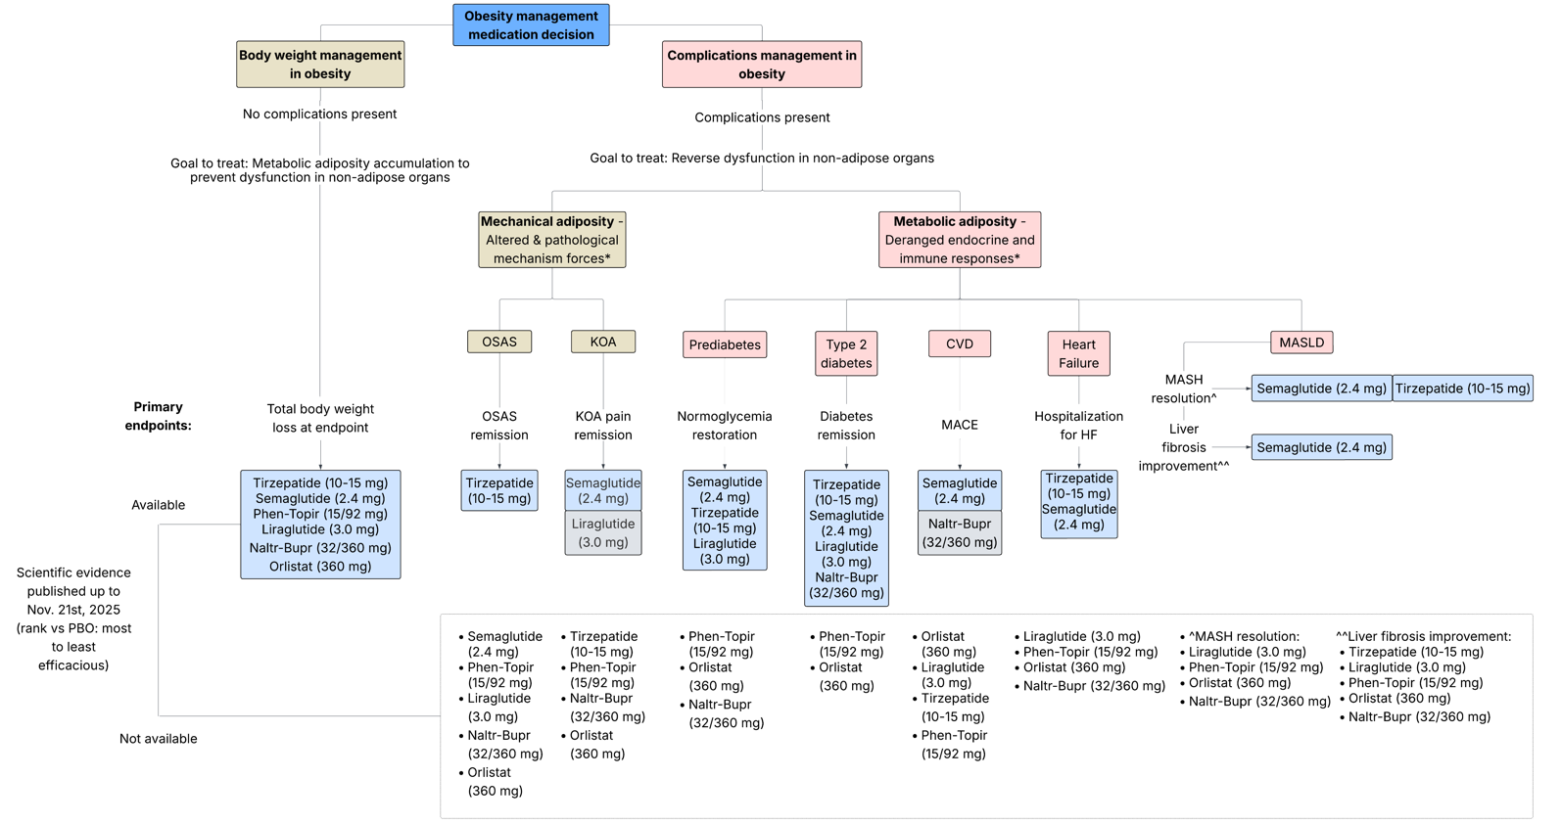
Updated 2026 EASO OMM algorithm: overview
Ciudin A et al. Nat Med 2026;32:1962-1966.
Notes:
Slide: Algorithm overview
• Orient the audience to the full algorithm before zooming in.
• Left branch: body weight management when no relevant complications dominate.
• Right branch: complication management, split into mechanical and metabolic adiposity.
• Explain the evidence axis: available significant (blue); available but not statistically significant (grey); and below, no relevant RCT evidence from review methodology or time window available for comparison.
• Transition: next we build the algorithm by endpoint, starting with the most mature and evolved evidence base – TBWL.

Slide 22
Evidence base for Algorithm v2
62
RCTs analysed
66
comparisons
63,909
participants
6 + 8
new primary + linked reports
Study rules
OMM nodes and doses
Adults with obesity or overweight
Treatment duration at least 48 weeks
Placebo- or active-controlled RCTs
EMA-approved OMMs available in at least one EASO member country
Orlistat 360 mg
Naltrexone/bupropion 32/360 mg
Liraglutide 3.0 mg
Semaglutide 2.4 mg
Phentermine/topiramate 15/92 mg
Tirzepatide 10-15 mg
Validated search cut-off for this update: End of 2025 (date of review searches 21/11/25 – however, post-hoc no new trials meeting inclusion criterion)
Ciudin A et al. Nat Med 2026;32:1962-1966.

Slide 23
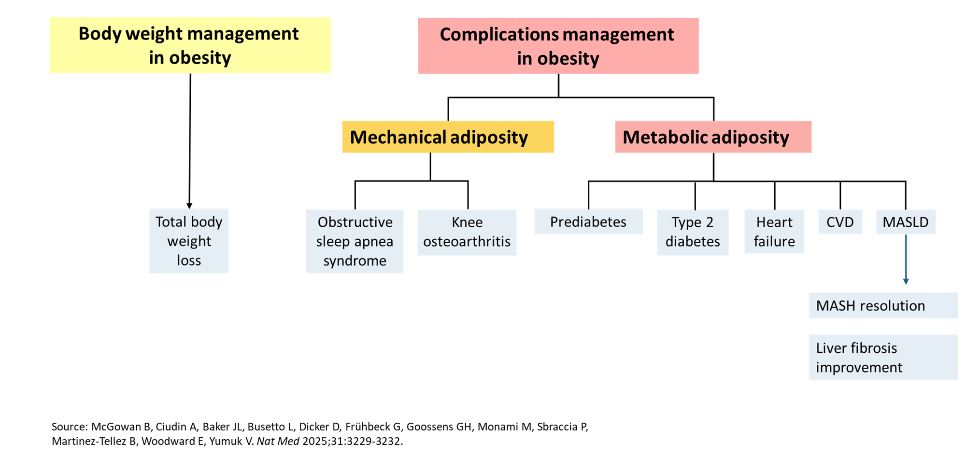
Evidence base for Algorithm v2
Primary and secondary endpoints: percentage total body weight loss at trial endpoint.
Complication-specific primary endpoints: OSAS remission, KOA improvement, normoglycaemia restoration, diabetes remission, MACE, HF hospitalisation, MASH resolution and fibrosis improvement.
NMA used when at least 10 RCTs contributed to a connected network; otherwise pairwise meta-analysis or descriptive reporting.

Slide 24
How to read the updated algorithm
1
2
3
Start with the person
Identify the goal
Apply judgement
No relevant complications: body weight management pathway.
Complications present: match treatment evidence to dominant complication and outcome.
Mechanical adiposity: OSAS and KOA.
Metabolic adiposity: prediabetes, T2D, CVD/HF and MASLD.
Blue nodes: statistically significant effect vs control.
Grey nodes: no significant effect (below line, no relevant OMM RCT meeting criteria).
Same line: no implied hierarchy.
The visual order is domain-specific efficacy for stated endpoints - not a prescribing sequence and not an overall ranking of medicines.
Ciudin A et al. Nat Med 2026;32:1962-1966.

Slide 25
Clinical use: evidence map for person-centred care
Treatment goal
Evidence maturity
Patient/system context
What outcome matters most?
How strong is the signal?
What is feasible?
Use the algorithm alongside guidelines, clinical judgement and shared decision-making.
Balance expected efficacy with safety, contraindications, tolerability, access, cost and patient preferences.
The update reinforces the message: choose OMMs according to the person’s complication profile and treatment goals - not weight loss alone.
The algorithm is an evidence- and expert-informed guide to individualised care, not a mandated sequence or substitute for clinical judgement.
Ciudin A et al. Nat Med 2026;32:1962-1966.

Slide 26
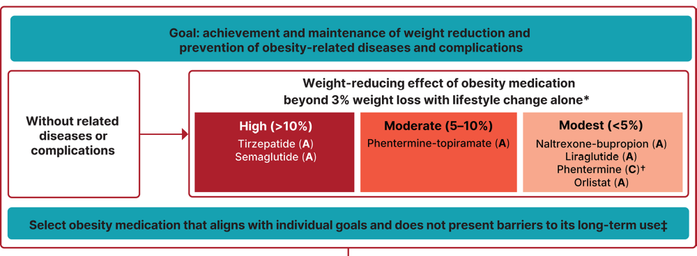
Other Pharmacologic Algorithms: ADA
ADA Professional Practice Committee for Obesity. BMJ Open Diabetes Res Care 2026;13(Suppl1):e005729

Slide 27
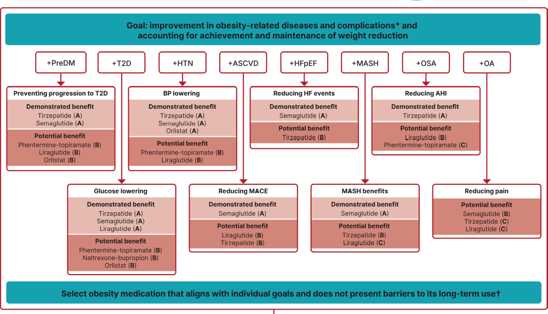
Other Pharmacologic Algorithms: ADA
ADA Professional Practice Committee for Obesity. BMJ Open Diabetes Res Care 2026;13(Suppl1):e005729

Slide 28
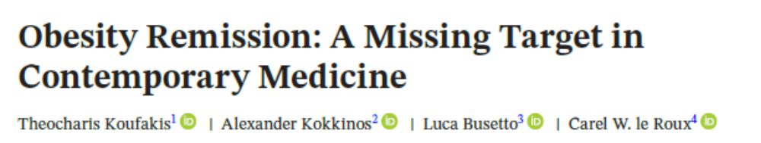
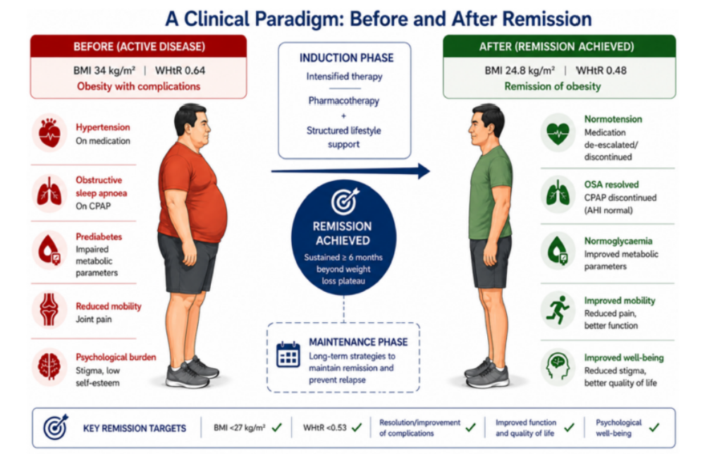
Koufakis T et al. Obes Rev. 2026;27:e70197.

Slide 29





Grazie
luca.busetto@unipd.it
Luca Busetto
@busetto_luca
luca.busetto.37

